Slide 1


A CASE FOR PREDICTING PRICE RATHER
THEN SCORE OR PRICE AND SCORE
Garrett Hawes

Slide 2

USE CASES

Slide 3
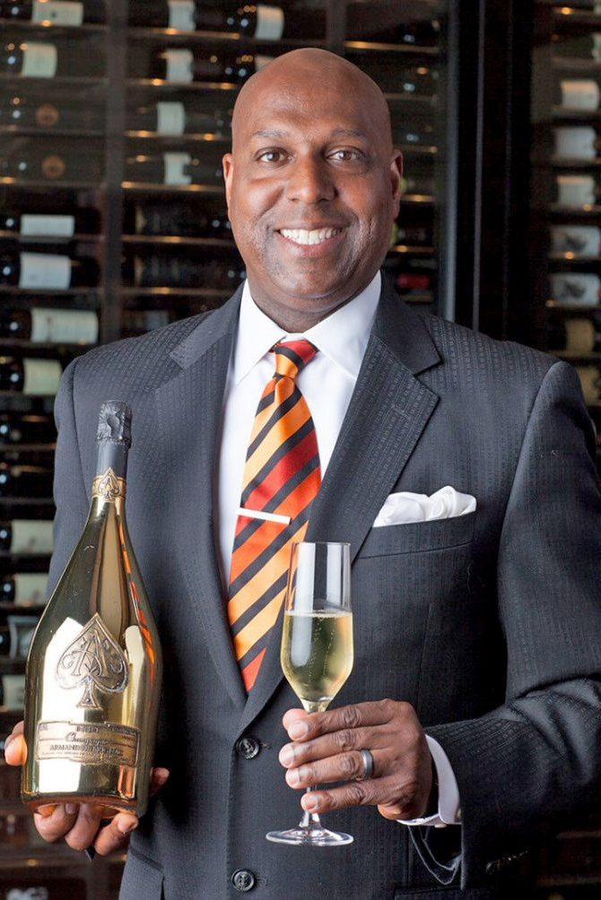
William Lewis
OWNER WINERY TUSTIN
William owns a restaurant with 3 locations, a menu of 650 wines (that change weekly) and a cellar that holds 7,500 bottles (at the main location, other locations are similar). They constantly need to select new wines for their menu. If a reliable model says x bottle costs them almost as much as people would expect to pay for it William probably does not want to add that wine to the menu. If the model suggests that a wine is under priced based on expectations, then they would want to promote it because they can sell glasses for a bigger markup than wines that are priced at or near expected price.

Slide 4
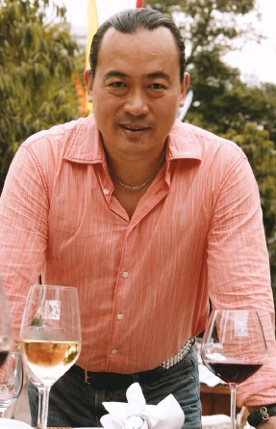
Michael Ma
WINE SPECULATOR, CHINA
Michael buys wine in large amounts as a commodity banking on the growing demand in China as a guaranteed path to high returns. If a reliable model predicts that a wine should cost $30 a bottle but is listed at $10 Michael might buy 10,000 bottles because when introduced into a new market prices can be set more in-line with the model's projections.
All other things being equal he likely would not invest in bottles that cost more than a model says they should cost.

Slide 5
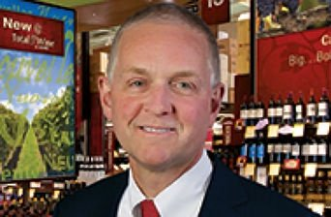
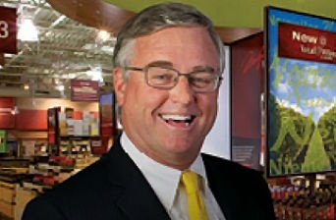
David & Robert Trone
OWNER TOTAL WINE
As owners of a wine retail chain if a model says that a wine should cost $20 a bottle but they need to sell it for $50 to be profitable they would likely not choose to stock it since it will not sell well. If the model says it should cost $50 but they could sell it at $20 and be profitable then they would want to dedicate shelf space given that it will likely sell well, and the price might adjust upwards while they are getting rid of their stock.

Slide 6
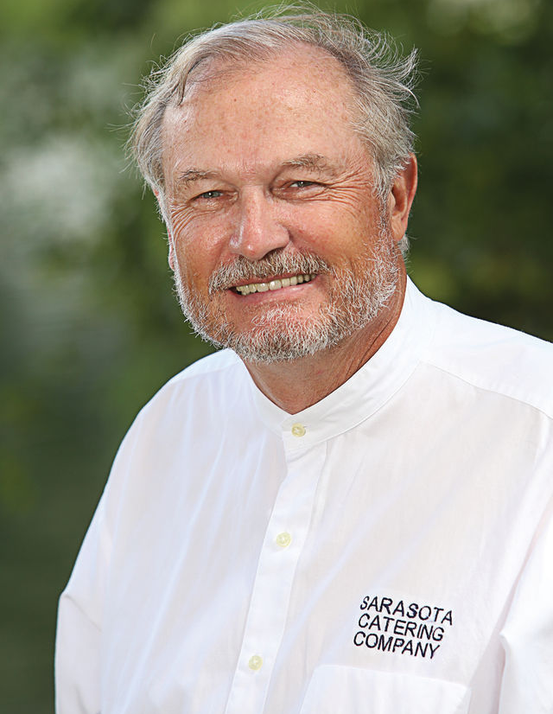
Lance Thompson
OWNER SARASOTA CATERING COMPANY
As a software designer turned caterer lance might use an algorithm based aproach to identify lesser known wines that are priced much lower than other wines that share the same charicteristics because he can charge much more to customers than he paid for them.

Slide 7
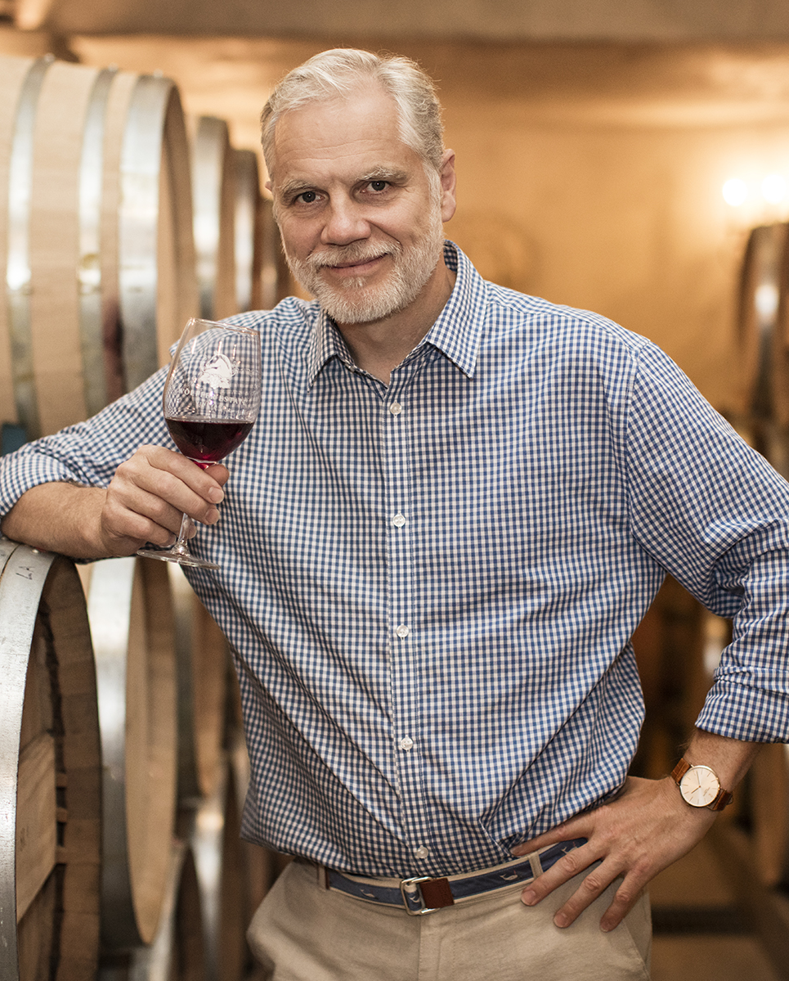
Roman Roth
OWNER WÖLFFER ESTATE
As a winemaker some things are not really under your control others are. If a reliable model told him that all other things being equal my return (expected sale price) would be significantly higher with a different crop he might choose to shift focus of his grapes. Or he might have to opportunity to purchase additional land which could grow any number of grape varieties, a model would help him choose what to grow. Or say he is trying to decide what to name a new wine. A model suggests that all other things being equal a wine with title x should command a 20% lower price than a wine with title y, so he names it y. Additionally he learns that if he produces a “reserve” wine in the same space his expected return for those costs is quite high so he decides to do that.

Slide 8

Jeffrey P Wannamaker
BUDDING WINE ENTHOUSIAST AND BANKER
Jeffrey recently got into wine and would like to stock the wine cellar in his newly purchased estate in the Hamptons. He has purchased some bottles that he knows he wants but he needs to purchase another 5,000 bottles and doesn’t want to spend the time carefully selecting them. He just wants to have a decent selection of bottles that his model says are a good deal (wines that should cost $100 a bottle but cost less than $50) he reaches out to his local wine distributor to get a spreadsheet of their inventory and orders 5,000 bottles of things that fit his wants.

Slide 9
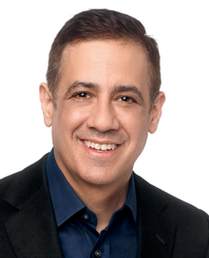
Michael Wolf
INVESTOR
Michael has two prospectuses from a potential wineries, he is trying to decide where to invest his money. His model tells him that winery A would need to sell its wine for at least $50 a bottle to be profitable regardless of the rating. His model tells him that entering all of the knowns from the plan the range of predicted prices for each possible review is between $6 and $15. Michael decides that investing in Winery A is a bad idea. Winery B has the opposite situation and he decides to give them the seed money. Alternatively winery B is not as clear so he uses montecarlo analysis along with his model for price to discover that there is a high likelihood that winery B will be able to meet its required price and succeed.

Slide 10
PRICE IS NON-FINITE
Most consumers do not have very sophisticated taste, other non taste factors can be just as important in what drives them to pay more or less. All the derived variables i.e. length of title, whether the title has any accents (i.e. if it sounds exotic), etc. … are irrelevant to rating since it is experts judging on taste. More to the point there are likely many variables that you can tweak to effect price. For rating all you can do is change the taste.
UP
DOWN

Slide 11
FURTHER CONTEXT FOR PRICE
Different realities
Taste (review)
Price
Marketing (choices presentation)
Contributing Factors
The variation of possible contributing factors is much larger in this case, and in fact many can be changed.
Realities (location, variety, etc..)
Review Score
Taste

Slide 12




A GOAL BASED APROACH
Value
Return for Winemakers
Trying to purchase wines that are a “good deal” ie cost less than they should.
What can I reasonably change about my wine that would result in a larger return for my investment in the same grapes.
Return on Investment
Service
What wines should I purchase or not purchase because their current price is out of line with what it should be.
What wines should I choose to have on the menu so that people can feel as though they are not being ripped off.

Slide 13

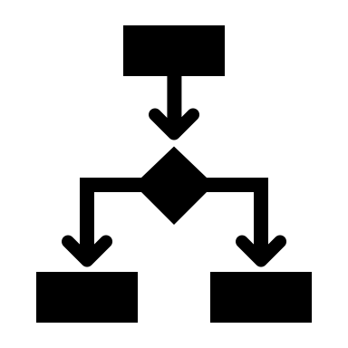
A LOGISTICAL MODEL APPROACH
If we are creative, we can make this approach fit.
Include Review exclude price
Leaving score in the model predictors and leaving price out will still fit in with other models that give you price but in this case what you are examining is your function of bang for $. Review score is found on the left- and right-hand side of the equations
Tree based models
The same would be true of tree-based models we would not have a tree with a terminal branch for every possible price but one for each category of price.
NOTE: I AM NOT SAYING THAT THIS IS THE APROACH TO TAKE ONLY THAT IT IS CONCEIVABLE THAT IT MIGHT BE A WAY TO INTEGRATE A LOGISTICAL REGRESSION INTO A SINGLE BUISNESS QUESTION

Slide 14

Thanks

